Slide 1
Synchronization in Java
Synchronization in java is the capability to control the access of multiple threads to any shared resource.
The synchronization is mainly used to
To prevent thread interference.
To prevent consistency problem.
There are two types of thread synchronization mutual exclusive and inter-thread communication.
Mutual Exclusive
Synchronized method.
Synchronized block.
static synchronization.
2. Cooperation (Inter-thread communication in java)

Slide 2
Unsynchronized Method
Class Table{
void printTable(int n){//method not synchronized
for(int i=1;i<=5;i++){
System.out.println(n*i);
try{
Thread.sleep(400);
}catch(Exception e){System.out.println(e);}
}
}
}
class MyThread1 extends Thread{
Table t;
MyThread1(Table t){
this.t=t;
}
public void run(){
t.printTable(5); }
}
} class MyThread2 extends Thread
{
Table t;
MyThread2(Table t){
this.t=t;
} public void run(){
t.printTable(100);
}
}
class TestSynchronization1{
public static void main(String args[]){
Table obj = new Table();//only one object
MyThread1 t1=new MyThread1(obj);
MyThread2 t2=new MyThread2(obj);
t1.start();
t2.start();
}
}

Slide 3
Synchronized Method
Class Table{
synchronized void printTable(int n)
{
for(int i=1;i<=5;i++){
System.out.println(n*i);
try{
Thread.sleep(400);
}catch(Exception e){System.out.println(e);}
}
}
}
class MyThread1 extends Thread{
Table t;
MyThread1(Table t){
this.t=t;
}
public void run(){
t.printTable(5); }
}
}
class MyThread2 extends Thread
{
Table t;
MyThread2(Table t){
this.t=t;
}
public void run(){
t.printTable(100);
}
}
class TestSynchronization1{
public static void main(String args[]){
Table obj = new Table();//only one object
MyThread1 t1=new MyThread1(obj);
MyThread2 t2=new MyThread2(obj);
t1.start();
t2.start();
}
}

Slide 4
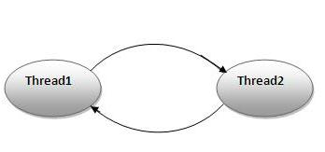
Deadlock
Deadlock can occur in a situation when a thread is waiting for an object lock, that is acquired by another thread and second thread is waiting for an object lock that is acquired by first thread.
Since, both threads are waiting for each other to release the lock, the condition is called deadlock.

Slide 5
public class TestDeadlockExample1 {
public static void main(String[] args) {
final String resource1 = "ratan jaiswal";
final String resource2 = "vimal jaiswal";
// t1 tries to lock resource1 then resource2
Thread t1 = new Thread() {
public void run() {
synchronized (resource1) {
System.out.println("Thread 1: locked resource 1");
try { Thread.sleep(100);} catch (Exception e) {}
synchronized (resource2) {
System.out.println("Thread 1: locked resource 2");
}
}
}
};
// t2 tries to lock resource2 then resource1
Thread t2 = new Thread() {
public void run() {
synchronized (resource2) {
System.out.println("Thread 2: locked resource 2");
try { Thread.sleep(100);} catch (Exception e) {}
synchronized (resource1) {
System.out.println("Thread 2: locked resource 1");
}
}
}
};
t1.start();
t2.start();
}
}

Slide 6
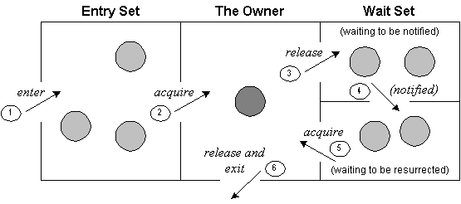
Inter-Thread Communication
Inter-thread communication or Co-operation is all about allowing synchronized threads to communicate with each other.
Cooperation (Inter-thread communication) is a mechanism in which a thread is paused running in its critical section and another thread is allowed to enter (or lock) in the same critical section to be executed.
It is implemented by following methods of Object class:
wait()
notify()
notifyAll()

Slide 7
class Customer{
int amount=10000;
synchronized void withdraw(int amount){
System.out.println("going to withdraw...");
if(this.amount<amount){
System.out.println("Less balance; waiting for deposit...");
try{wait();}catch(Exception e){}
}
this.amount-=amount;
System.out.println("withdraw completed...");
}
synchronized void deposit(int amount){
System.out.println("going to deposit...");
this.amount+=amount;
System.out.println("deposit completed... ");
notify();
}
}
class Test
{
public static void main(String args[])
{
final Customer c=new Customer();
new Thread()
{
public void run(){c.withdraw(15000);}
}.start();
new Thread()
{
public void run()
{
c.deposit(10000);}
}.start();
}}

